Slide 1
Sentence types
What is the meaning of a sentence?
The lion devoured the pizza.
Statement
Notes:
preamble: What is natural language meaning? To understand this, we should think about the primary (though maybe not exclusive) purpose of language: communication. We use language to exchange information with other people who know the same language. How do we characterize this information, how is it packaged? Let’s start with something fairly coarse grained. English (and all other languages) has different types of sentences, with different functions in a discourse.
----- Meeting Notes (11/30/15 11:19) -----
"provide positive information about the world"

Slide 2
Sentence types
What is the meaning of a sentence?
Who devoured the pizza?
Did the lion devour the pizza?
Question
Notes:
----- Meeting Notes (11/30/15 11:19) -----
"request a particular piece of information"

Slide 3
Sentence types
What is the meaning of a sentence?
Do your homework!
Have a cookie!
Command
Notes:
----- Meeting Notes (11/30/15 11:28) -----
Demand (or suggest) that you add a particular activity to your mental to-do list

Slide 4
Sentence types
What is the meaning of a sentence?
Do you know what time it is?
Q: Does Bill have a girlfriend?
A: He’s been going to New York an awful lot, lately.
Sentences might convey additional non-literal meaning

Slide 5
What do sentences mean?
(1) The capital of Canada is Ottawa
(2) The capital of Canada is Montreal
Notes:
----- Meeting Notes (11/30/15 11:28) -----
Let's narrow our focus to assertions (statements) and their literal meaning. What's the difference between (1) and (2)?

Slide 6
What do sentences mean?
(1) The capital of Canada is Ottawa
(2) The capital of Canada is Montreal
In the actual world:
  (1) is True
  (2) is False
The meaning of a sentence is related to whether it is true or false (its truth value).

Slide 7
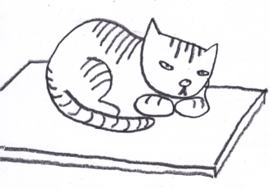
What do sentences mean?
BUT: This can’t be all, since the truth-values of sentences can change over time or situations
Chris is in his office.
The cat is on the mat
Notes:
----- Meeting Notes (11/29/15 21:01) -----
change to "his office"

Slide 8
What do sentences mean?
We can grasp the meaning of a sentence without knowing whether it’s true or false.
The name of the person sitting closest to the door starts with a “D.”

Slide 9
What do sentences mean?
We can grasp the meaning of sentences we’ve never heard before.
The orange turtle devoured the red jalapeno pepper.
Notes:
----- Meeting Notes (11/29/15 21:01) -----
red >> pink

Slide 10
Definition: Semantics and meaning
To know the meaning of a sentence is to know its truth conditions.
  That is, we know what the world would have to look like in order for the sentence to be true.
Notes:
----- Meeting Notes (11/29/15 21:01) -----
situation >> context

Slide 11
Definition: Semantics and meaning
To know the meaning of a sentence is to know its truth conditions.
  That is, we know what the world would have to look like in order for the sentence to be true.
The semantic competence of a speaker:
The ability, when presented with a sentence and a situation, to tell whether the sentence is true or false in the situation.
Notes:
----- Meeting Notes (11/29/15 23:45) -----
Say something about "competence" how linguistic theory is theory of tacit knowledge (i.e. competence). semantics is just another part of linguistic theory.
----- Meeting Notes (11/30/15 11:57) -----
"the ability to figure out the truth conditions for all the well-formed sentences in a speaker's langauge”
maybe mention that this probably won’t be adequate for questions, maybe not for commands either.

Slide 12
Building a semantic system
How can we specify the meanings of infinitely many sentences in natural language?
The scary lion devoured the mushroom pizza that I ordered last night
Notes:
We saw last week that syntax can construct infinitely many grammatical sentences

Slide 13
Building a semantic system
Observation: The interpretation of a sentence depends on its syntactic structure. Different phrases make predictable contributions to the meaning of a sentence.
The cat chased the rat

Slide 14
Building a semantic system
Observation: The interpretation of a sentence depends on its syntactic structure. Different phrases make predictable contributions to the meaning of a sentence.
The cat chased the rat
The rat chased the cat

Slide 15
Building a semantic system
Observation: The interpretation of a sentence depends on its syntactic structure. Different phrases make predictable contributions to the meaning of a sentence.
The cat chased the rat
The rat chased the cat
The grey cat chased the rat

Slide 16
Building a semantic system
Observation: The interpretation of a sentence depends on its syntactic structure. Different phrases make predictable contributions to the meaning of a sentence.
The cat chased the rat
The grey cat chased the rat
The grey cat with the hat chased the rat

Slide 17
Building a semantic system
Observation: The interpretation of a sentence depends on its syntactic structure. Different phrases make predictable contributions to the meaning of a sentence.
The cat chased the rat
The cat chased the dog

Slide 18
Building a semantic system
Observation: The interpretation of a sentence depends on its syntactic structure. Different phrases make predictable contributions to the meaning of a sentence.
The cat chased the rat
The cat licked the rat

Slide 19
Building a semantic system
Observation: The interpretation of a sentence depends on its syntactic structure. Different phrases make predictable contributions to the meaning of a sentence.
The cat chased the rat
A cat chased the rat

Slide 20
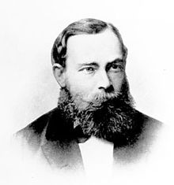
Definition: Compositional semantics
The principle of compositionality
(Frege’s conjecture):
The meaning of a sentence depends
only on the meanings of its parts
and on the way that they are
syntactically combined.
Gottlob Frege (1848-1925)

Slide 21
Definition: Compositional semantics
The principle of compositionality
(Frege’s conjecture):
The meaning of a sentence depends
only on the meanings of its parts
and on the way that they are
syntactically combined.
The task of the semantics of a language is to provide the truth-conditions of all the well-formed sentences in that language, and to do so in a compositional way

Slide 22
Basic modeling
Milo is gray
Milo is a cat
Milo purred
We can define adjectives, nouns and intransitive verbs as mathematical sets of individuals.
TP
T’
NP
purred

is gray
is a cat
Notes:
----- Meeting Notes (11/29/15 23:45) -----
We start by taking a sentence and decomposing its meaning (guided by syntactic structure) into more basic parts.
Basic syntactic structure.
ask students: do you know what a set is?

Slide 23
Basic modeling
Milo is gray
Milo is a cat
Milo purred
A set is a collection of objects.
Gray is the collection of all gray individuals.
Cat is the collection of all individuals who are cats.
Purred is the collection of all individuals who purred.
IP
I’
NP
purred

is gray
is a cat

Slide 24
Basic modeling
Milo is gray
Milo is a cat
Milo purred
Milo is a member of the
set of individuals that are gray.
Milo ∈ Gray
IP
I’
NP
purred

is gray
is a cat
Notes:
notice: this is a statement which can be true or false, i.e. it has a truth value (and anyone who knows what’s in the relevant set can easily check the truth value)

Slide 25
Basic modeling
Milo is gray
Milo is a cat
Milo purred
Milo is a member of the
set of individuals that are cats.
Milo ∈ Cat
IP
I’
NP
purred

is gray
is a cat

Slide 26
Basic modeling
Milo is gray
Milo is a cat
Milo purred
Milo is a member of the
set of individuals that purred.
Milo ∈ Purred
IP
I’
NP
purred

is gray
is a cat
Notes:
ask students: What about Milo is a gray cat?

Slide 27
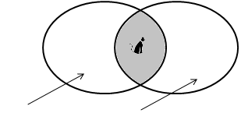
Modification
Milo [_{I’} is a gray cat ]
Set intersection: The set that results from combining two other sets
Milo ∈ Gray ∩ Cat
Cat Gray

Slide 28
Modification
Set intersection can describe other adjectives too:
Milo is a gray cat
Gianni is an Italian waiter
T-Rex is a carnivorous dinosaur
This is a round ball
These are called intersective adjectives.

Slide 29
Modification
Intersective adjectives conform to an entailment pattern.
A entails B iff whenever A is true, B is true.

Slide 30
Modification
Intersective adjectives conform to an entailment pattern.
A entails B iff whenever A is true, B is true.
Milo is a gray cat
Milo is a cat
Milo is gray
Notes:
Ask students: Can you think of any *non*-intersective adjectives?

Slide 31
Modification
There are also non-intersective adjectives:
Bill is a former president
That is a fake diamond

Slide 32
Modification
There are also non-intersective adjectives:
Bill is a former president
This is a fake diamond
The entailment pattern doesn’t hold:
Bill is a former president
Bill is a president [not valid]
??Bill is former [not valid]

Slide 33
Modification
There are also non-intersective adjectives:
Bill is a former president
This is a fake diamond
In fact:
Bill is a former president
Bill is not a president
Bill was a president in the past

Slide 34
Connectives
Milo [_{I’} is gray and furry ]
Connectives can be described in set terms.
AND denotes set intersection
Gray ∩ Furry
Grey Furry
Notes:
----- Meeting Notes (11/29/15 11:06) -----
Another form of modificiation involves connective words
suppose I combine two adjectives wit h the word *and*
----- Meeting Notes (11/29/15 23:45) -----
ask students how they would define "gray or black"

Slide 35
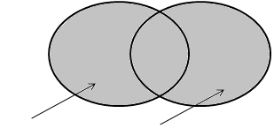
Connectives
Milo [_{I’} is gray or black ]
Connectives can be described in set terms.
OR denotes set union
Gray ∪ Black
Gray Black

Notes:
use venn diagrams/board to help students understand set theoretic union

Slide 36
Interim summary
Nouns, intransitive verbs, and adjectives can be described using set membership.
is a cat Cat
Milo is gray = ∈ Gray
purred Purred

Slide 37
Interim summary
Intersective adjectives can be described using set intersection:
Milo is a gray cat = ∈ Gray ∩ Cat
AND can also be described using set intersection.
Milo is gray AND furry = ∈ Gray ∩ Furry
OR can also be described using set union.
Milo is gray OR black = ∈ Gray ∪ Black
Notes:
----- Meeting Notes (11/29/15 11:06) -----
also add modification

Slide 38
More modeling
Proper names pick out individuals in the world.
John danced

Slide 39
More modeling
Proper names pick out individuals in the world.
John danced
What does some boy refer to?
Some boy danced

Slide 40
More modeling
Proper names pick out individuals in the world.
John danced
What does some boy refer to?
Some boy danced
What about no boy?
No boy danced

Slide 41
Determiners
English has several additional determiners:
Some boy danced
No boy danced
Three boys danced
More than half of the boys danced
Every boy danced

Slide 42
Determiners
How do we model determiners?
Some boy danced
No boy danced
Three boys danced
More than half of the boys danced
Every boy danced
Notes:
----- Meeting Notes (11/30/15 12:42) -----
how to we build on our earlier theory to model these?

Slide 43
Determiners
How do we model determiners?
Some boy danced
No boy danced
Three boys danced
More than half of the boys danced
Every boy danced
NPs with determiners don’t refer to individuals. Rather, determiners denote set relations.

Slide 44
Determiners
Some boy danced
The intersection of the set of boys and the set of dancers is not empty
Boy ∩ Danced ≠ ∅
Boy
Danced
⓪

Slide 45
Determiners
Some boy danced
Can there be boys who are not dancers?
Can there be dancers who are not boys?
Boy
Danced
⓪

Slide 46
Determiners
Some boy danced
Can there be boys who are not dancers? Yes.
Can there be dancers who are not boys? Yes.
Boy
Danced
⓪
⓪
①
Notes:
what about: No boy danced ?

Slide 47
Determiners
No boy danced
The intersection of the set of boys and the set of dancers is empty
Boy ∩ Danced = ∅
Boy
Danced

Slide 48
Determiners
No boy danced
Can there be boys who are not dancers?
Can there be dancers who are not boys?
Boy
Danced

Slide 49
Determiners
No boy danced
Can there be boys who are not dancers? Yes.
Can there be dancers who are not boys? Yes.
Boy
Danced
⓪
①

Slide 50
Determiners
Three boys danced
The intersection of the set of boys and the set of dancers contains three elements.
| Boy ∩ Danced | = 3
Boy
Danced
⓪⓪
⓪
Notes:
what about: three boys danced?

Slide 51
Determiners
Three boys danced
Can there be boys who are not dancers?
Can there be dancers who are not boys?
Boy
Danced
⓪⓪
⓪

Slide 52
Determiners
Three boys danced
Can there be boys who are not dancers? Yes.
Can there be dancers who are not boys? Yes.
Boy
Danced
⓪
⓪⓪
⓪
①
Notes:
what about: more than half of the boys danced?

Slide 53
Determiners
More than half of the boys danced
The intersection of the set of boys and the set of dancers contains more than half of all the boys.
| Boy ∩ Danced | > ½ | Boy |
Boy
Danced
⓪
⓪
⓪⓪
⓪

Slide 54
Determiners
More than half of the boys danced
Can there be boys who are not dancers?
Can there be dancers who are not boys?
Boy
Danced
⓪
⓪
⓪⓪
⓪

Slide 55
Determiners
More than half of the boys danced
Can there be boys who are not dancers? Yes
Can there be dancers who are not boys? Yes.
Boy
Danced
⓪
⓪
⓪⓪
⓪
①

Slide 56
Determiners
Every boy danced
The set of boys is a subset of the set of dancers.
Boy ⊆ Danced
Boy
Danced
⓪⓪⓪⓪
⓪⓪⓪

Slide 57
Determiners
Every boy danced
Can there be boys who are not dancers?
Can there be dancers who are not boys?
Boy
Danced
⓪⓪⓪⓪
⓪⓪⓪

Slide 58
Determiners
Every boy danced
Can there be boys who are not dancers? No.
Can there be dancers who are not boys? Yes.
Boy
Danced
⓪⓪⓪⓪
⓪⓪⓪
①

Slide 59
Determiners summary
All the sentences we have seen have the structure:
Det(A)(B)
Some(Boy)(Danced)
Three(Boy)(Danced)
More than half(Boy)(Danced)
No(Boy)(Danced)
Every(Boy)(Danced)

Slide 60
Determiners summary
All the sentences we have seen have the structure:
Det(A)(B)
Some(Boy)(Danced) ⇔ Boy ∩ Danced ≠ ∅
Three(Boy)(Danced)
More than half(Boy)(Danced)
No(Boy)(Danced)
Every(Boy)(Danced)
Notes:
----- Meeting Notes (11/29/15 11:06) -----

Slide 61
Determiners summary
All the sentences we have seen have the structure:
Det(A)(B)
Some(Boy)(Danced) ⇔ Boy ∩ Danced ≠ ∅
Three(Boy)(Danced) ⇔ | Boy ∩ Danced | = 3
More than half(Boy)(Danced)
No(Boy)(Danced)
Every(Boy)(Danced)
Notes:
----- Meeting Notes (11/29/15 23:45) -----
class participation: before revelating each denotation ask students what it was.

Slide 62
Determiners summary
All the sentences we have seen have the structure:
Det(A)(B)
Some(Boy)(Danced) ⇔ Boy ∩ Danced ≠ ∅
Three(Boy)(Danced) ⇔ | Boy ∩ Danced | = 3
More than half(Boy)(Danced) ⇔ | Boy ∩ Danced | > ½ | Boy |
No(Boy)(Danced)
Every(Boy)(Danced)

Slide 63
Determiners summary
All the sentences we have seen have the structure:
Det(A)(B)
Some(Boy)(Danced) ⇔ Boy ∩ Danced ≠ ∅
Three(Boy)(Danced) ⇔ | Boy ∩ Danced | = 3
More than half(Boy)(Danced) ⇔ | Boy ∩ Danced | > ½ | Boy |
No(Boy)(Danced) ⇔ Boy ∩ Danced = ∅
Every(Boy)(Danced)

Slide 64
Determiners summary
All the sentences we have seen have the structure:
Det(A)(B)
Some(Boy)(Danced) ⇔ Boy ∩ Danced ≠ ∅
Three(Boy)(Danced) ⇔ | Boy ∩ Danced | = 3
More than half(Boy)(Danced) ⇔ | Boy ∩ Danced | > ½ | Boy |
No(Boy)(Danced) ⇔ Boy ∩ Danced = ∅
Every(Boy)(Danced) ⇔ Boy ⊆ Danced

Slide 65
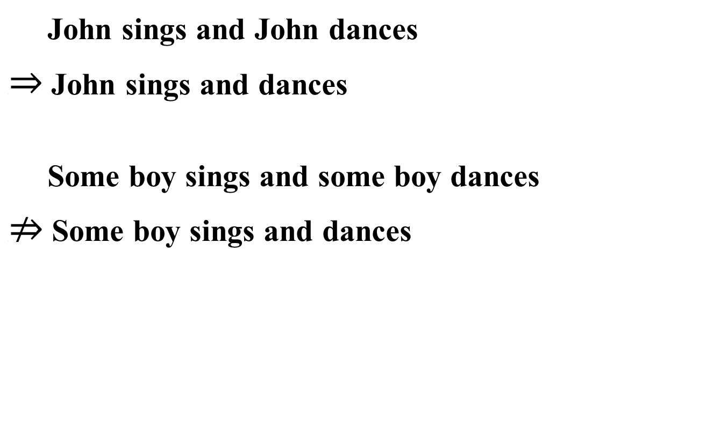
An application: Explaining entailment patterns
John sings and John dances
.$⇒$ John sings and dances
Some boy sings and some boy dances
.$⇏$ Some boy sings and dances

Slide 66

An application: Explaining entailment patterns
John sings and John dances
.$⇒$ John sings and dances
S
D
John

Slide 67

An application: Explaining entailment patterns
Some boy sings and some boy dances
.$⇏$ Some boy sings and dances

Slide 68
An application: Explaining entailment patterns
Some boy sings and some boy dances
.$⇏$ Some boy sings and dances
B
S
D

Slide 69
An application: Explaining entailment patterns
Some boy sings and some boy dances
B
S
D

Slide 70
An application: Explaining entailment patterns
Some boy sings and some boy dances
B
S
⓪
D

Slide 71
An application: Explaining entailment patterns
Some boy sings and some boy dances
B
S
⓪
⓪
D

Slide 72
An application: Explaining entailment patterns
Some boy sings and dances
B
S
D

Slide 73
An application: Explaining entailment patterns
Some boy sings and dances
B
S
⓪
D

Slide 74
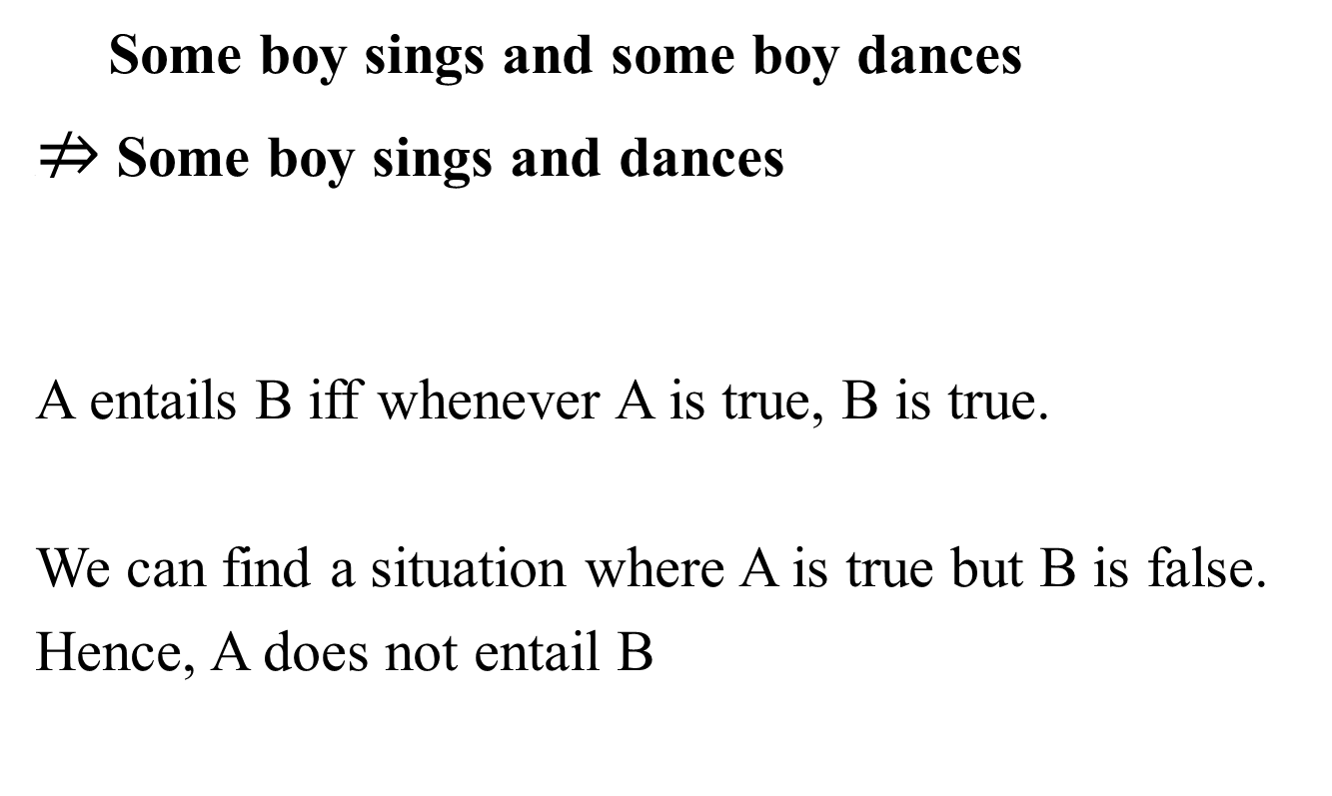
An application: Explaining entailment patterns
Some boy sings and some boy dances
.$⇏$ Some boy sings and dances
A entails B iff whenever A is true, B is true.
We can find a situation where A is true but B is false.
Hence, A does not entail B

Slide 75
Properties of determiners
All the sentences we have seen have the structure:
Det(A)(B)
All the determiners we have seen so far put restrictions on members of set A, but not on members of set B.

Slide 76
Properties of determiners
All the sentences we have seen have the structure:
Det(A)(B)
Are there determiners that put restrictions on set B?

Slide 77
All the sentences we have seen have the structure:
Det(A)(B)
Now imagine that we have two sets A, A’
where:
A
A’

Slide 78
E.g.
A = DOGS
A’ = MAMMALS
Dogs
Mammals

Slide 79
What kinds of entailment patterns do we get for
Det(DOG)(PET)
and
Det(MAMMAL)(PET)

Slide 80
Example: Every(A)(B):
Every(MAMMAL)(PET) ⇒ Every(DOG)(PET)
Every(DOG)(PET) ¬ ⇒ Every(MAMMAL)(PET)
Dogs
Mammals
Pets

Slide 81
Example: Every(A)(B):
Every(MAMMAL)(PET)
Mammals
Pets

Slide 82
Example: Every(A)(B):
Every(DOG)(PET)
Dogs
Pets

Slide 83
E.g.
A = DOGS ⊆ MAMMALS
Dogs
Mammals

Slide 84
Example: Every(A)(B):
Every(MAMMAL)(PET) ⇒ Every(DOG)(PET)
Every(DOG)(PET) ¬ ⇒ Every(MAMMAL)(PET)
Dogs
Mammals
Pets

Slide 85
For Every(A)(B), the A argument is downward-entailing:
Whenever A ⊆ A’
Then Every(A’)(B)
↓
Then Every(A)(B)

Slide 86
What kinds of entailment patterns do we get for
Det(PET)(DOG)
and
Det(PET)(MAMMAL)

Slide 87
Example: Every(A)(B):
Every(PET)(MAMMAL) ¬ ⇒ Every(PET)(DOG)
Pets
Dogs
Mammals

Slide 88
Example: Every(A)(B):
Every(PET)(DOG) ⇒ Every(PET)(MAMMAL)
Pets
Dogs
Mammals

Slide 89
For Every(A)(B), the A argument is upward-entailing:
Whenever A ⊆ A’
Then Every(B)(A’)
↑
Then Every(B)(A)

Slide 90
Why is this important?
Think for a minute about where words and phrases like the following can appear:
    any
    lift a finger
    ever
    give a red cent
    budge an inch

Slide 91
A.
Every(one who lifted a finger to help Mary)(got a reward)
B.
*Every(one who got a reward)(lifted a finger to help Mary)
What does this tell us?

Slide 92
We can see this with other sentences, too
Milo is a dog ⇒ Milo is a mammal
*Milo ate any cookies.
*Milo lifted a finger.
Mammals
Dogs

Slide 93
We can see this with other sentences, too
Milo is not a mammal ⇒ Milo not is a dog
*Milo did not ate any cookies.
*Milo did not lifted a finger.
Mammals
Dogs

Slide 94
Properties of determiners
All the sentences we have seen have the structure:
Det(A)(B)
For example, every-non(A)(B)
blarg boy danced
= every non-boy danced
That is: A⁻ ⊆ B

Slide 95
Properties of determiners
All the sentences we have seen have the structure:
Det(A)(B)
For example, Reverse-mth(A)(B)
blick boys danced
= more than half of the dancers are boys
That is: | A ∩ B | > ½ | B |

Slide 96
Conservativity
Natural language determiners only “care” about elements that satisfy their first argument.
Det is conservative if Det(A)(B) ⇔ Det(A)(A∩B):
every(boy)(danced) conservative
= every boy danced
= every boy is a boy that danced
every-non(boy)(danced) non-conservative
= every non-boy danced
≠ every non-boy is a boy that danced [*]

Slide 97
Conservativity
Natural language determiners only “care” about elements that satisfy their first argument.
Det is conservative if Det(A)(B) ⇔ Det(A)(A∩B):
more than half(boy)(danced) conservative
= more than half of the boys danced
= more than half of the boys are boys who danced
Reverse-mth(boy)(danced) non-conservative
= more than half of the dancers are boys
≠ more than half of the boys who danced are boys [*]

Slide 98
Conservativity
Universal: All natural language determiners are conservative.
Therefore: no language has a simple determiner that means every-non or Reverse-mth
blarg boys danced Does not exit!
= every non-boy danced
blick boys danced Does not exit!
= more than half of the dancers are boys

Slide 99
The definite article
What is the meaning of the definite article?
Some cat purred
Every cat purred
The cat purred

Slide 100
The definite article
What is the meaning of the definite article?
Some cat purred ⇔ Cat ∩ Purred = ∅
Every cat purred ⇔
The cat purred ⇔
Notes:
----- Meeting Notes (11/30/15 00:16) -----
this is wrong! leave it for students to find

Slide 101
The definite article
What is the meaning of the definite article?
Some cat purred ⇔ Cat ∩ Purred = ∅
Every cat purred ⇔ Cat ⊆ Purred
The cat purred ⇔

Slide 102
The definite article
What is the meaning of the definite article?
Some cat purred ⇔ Cat ∩ Purred = ∅
Every cat purred ⇔ Cat ⊆ Purred
The cat purred ⇔ ?

Slide 103
The definite article
The unicorn in central square is really mean.

Slide 104
The definite article
The unicorn in central square is really mean.
There is a unicorn in central square.
The unicorn is really mean.

Slide 105
The definite article
The unicorn in central square is really mean.
There is a unicorn in central square.
The unicorn is really mean.
The expression the unicorn in C.S. presupposes:
Existence: there exists a unicorn in C.S.
Uniqueness: there is exactly one (relevant) unicorn in C.S.
Notes:
We've already seen the truth conditions of sentences, plus entailments which follow from them. Here we see a slightly different sort of inference: a presupposition.
For uniquness, describe a universe where a heard of unicorns lives in central square.

Slide 106
The definite article
The expression the unicorn in C.S. presupposes:
Existence: there exists a unicorn in C.S.
Uniqueness: there is exactly one (relevant) unicorn in C.S.
When there is exactly one relevant individual in NP, the returns that individual.
the unicorn well defined iff there is one u∈Unicorn. Returns u.

Slide 107
Presuppositions of the
The presuppositions of the definite often spring into existence, even if they weren’t known beforehand.
I forgot to feed the cat this morning
Notes:
Change this: introduce concept of presupposition failure

Slide 108
Presuppositions of the
The presuppositions of the definite often spring into existence, even if they weren’t known beforehand.
I forgot to feed the cat this morning
You will accommodate the fact that I have a cat.

Slide 109
Presuppositions of the
The presuppositions of the definite often spring into existence, even if they weren’t known beforehand.
I forgot to feed the cat this morning
You will accommodate the fact that I have a cat.
If no one objects to what I said, the assumption that I have a cat will be added to the common ground of our conversation.

Slide 110
Accommodation
How easy it is to accommodate depends on the plausibility of what I said.

Slide 111
Accommodation
How easy it is to accommodate depends on the plausibility of what I said.
Context: We are at my house and you hear some scratching noises outside.
(1) The cat is at the door.
(2) The giraffe is at the door.
(3) I have a pet giraffe. The giraffe is at the door.
Notes:
----- Meeting Notes (11/29/15 11:06) -----
change to: I have a pet giraffe.

Slide 112
Accommodation
Normally, we assume that speakers intend to say things that are grammatical, relevant, and – often – true.
In the closet, you will find the blue coat

Slide 113
Accommodation
Normally, we assume that speakers intend to say things that are grammatical, relevant, and – often – true.
In the closet, you will find the blue coat
Suppose that after I said this sentence, you open the closet and find only a black coat.

Slide 114
Accommodation
Normally, we assume that speakers intend to say things that are grammatical, relevant, and – often – true.
In the closet, you will find the blue coat
Suppose that after I said this sentence, you open the closet and find only a black coat.
You may assume I just got the color confused.

Slide 115
Accommodation
Normally, we assume that speakers intend to say things that are grammatical, relevant, and – often – true.
In the closet, you will find the blue coat
Suppose that after I said this sentence, you open the closet and find only a black coat.
Or you might assume you got the color confused and it’s really a dark blue coat.

Slide 116
Accommodation
We use a similar process to choose the meaning of ambiguous sentences.
Notes:
----- Meeting Notes (11/30/15 00:16) -----
"our decision about what parse to assign"...

Slide 117
Accommodation
We use a similar process to choose the meaning of ambiguous sentences.
Successful lawyers and linguists are always rich

Slide 118
Accommodation
We use a similar process to choose the meaning of ambiguous sentences.
Successful lawyers and linguists are always rich
a. [Successful lawyers] and linguists are always rich
b. Successful [lawyers and linguists] are always rich

Slide 119
Accommodation
We use a similar process to choose the meaning of ambiguous sentences.
Successful lawyers and linguists are always rich
a. [Successful lawyers] and linguists are always rich
b. Successful [lawyers and linguists] are always rich
Since (a) is obviously false, you’ll normally conclude that I meant (b).

Slide 120
Accommodation
Sometimes we can’t accommodate a presupposition.
I forgot to feed the cat this morning!
I forgot to feed the giraffe this morning!

Slide 121
Accommodation
Sometimes we can’t accommodate a presupposition.
I forgot to feed the cat this morning!
I forgot to feed the giraffe this morning!
The TA for 24.900 is from Indiana.
→ Uniqueness is violated!
The king of France is bald
→ Existence is violated!
Notes:
----- Meeting Notes (11/30/15 00:16) -----
change sentence

Slide 122
Conclusion
The king of France is bald
Modeling using sets: We defined intransitive verbs, nouns and adjectives as sets of individuals.
IP
I’
NP
is bald

Slide 123
Conclusion
The king of France is bald
Modeling using sets: We defined connectives (and, or) and determiners (some, every, no, three, more than half) as relations between two sets.

Slide 124
Conclusion
Compositionality: We calculated the meaning of sentences from the meaning of their parts and the syntactic structure they were in.

Slide 125
Conclusion
Compositionality: We calculated the meaning of sentences from the meaning of their parts and the syntactic structure they were in.
The meanings we calculated derived the truth conditions of the sentences.

Slide 126
Conclusion
Compositionality: We calculated the meaning of sentences from the meaning of their parts and the syntactic structure they were in.
The meanings we calculated derived the truth conditions of the sentences.
When combined with a context, we yield a truth value

Slide 127
Conclusion
Finally, we discussed the definite article and its presuppositions.
The king of France is bald
Existence
Uniqueness

